Slide 1
AJAX & json

Slide 2

What is ajax ?
Asynchronous JavaScript And XML.

Slide 3
Technology –
XML
HTML
CSS
JAVASCRIPT
* XML + HTML = XHTML

Slide 4
FACTS ABOUT ajax ?
Asynchronous JavaScript And XML.

Slide 5
AJAX is not a programming language.
It is a technique for creating fast and dynamic web pages.
AJAX is a technique for accessing web servers from a web page.
AJAX is a web browser technology independent of web server software.
Data is stored in XML format and fetched from the server.
The idea of AJAX was proposed by Jesse James Garrett in 2005.

Slide 6
Key point -
Allows web pages to update asynchronously by exchanging small amounts of data with the server behind the scenes.
Enhances the user experience by updating parts of a web page without reloading the whole page.
AJAX just uses a combination of:
A browser built-in XMHttpRequest Object
JavaScript and HTML DOM
* CORE COMPONENT OF AJAX?

Slide 7
Working ?

Slide 8
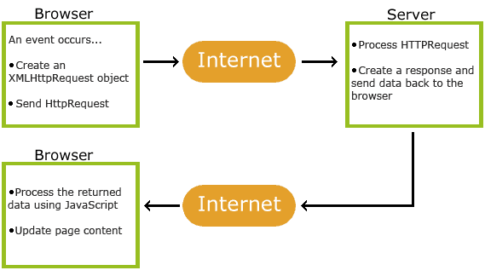

Slide 9

1. An event occurs in a web page (page is loaded, button is clicked)
2. An XMLHttpRequest object is created by JavaScript
3. The XMLHttpRequest object sends a request to a web server
4. The server processes the request
5. The server sends a response back to the web page
6. The response is read by JavaScript
7. Proper action (like page update) is performed by JavaScript
* What Better
Ans: ???

Slide 10
1. An event occurs in a web page (page is loaded, button is clicked)
2. An XMLHttpRequest object is created by JavaScript
3. The XMLHttpRequest object sends a request to a web server
4. The server processes the request
5. The server sends a response back to the web page
6. The response is read by JavaScript
7. Proper action (like page update) is performed by JavaScript
* What Better ?
Ans: Fetch API

Slide 11
What is JSON ?
JavaScript Object Notation

Slide 12
FACTS ABOUT JSON?
JavaScript Object Notation

Slide 13
It is a lightweight data-interchange format.
JSON is plain text written in JavaScript object notation.
JSON is a text format for storing and transporting data.
JSON format was originally specified by Douglas Crockford.
JSON is language independent *

Slide 14
Why Use JSON?
JavaScript Object Notation

Slide 15
2 main functionality of JSON?
JavaScript Object Notation

Slide 16
JavaScript has a built in function for converting JSON strings into JavaScript objects:
JSON.parse()
JavaScript also has a built in function for converting an object into a JSON string:
JSON.stringify()
JavaScript has a built-in function for converting JSON strings into JavaScript objects:
JSON.parse()
JavaScript also has a built-in function for converting an object into a JSON string:
JSON.stringify()

Slide 17
What make ajax & json work together ?
Asynchronous JavaScript And XML.
&
JavaScript Object Notation

Slide 18
THANK YOU

